Slide 1
Financial Systems and their Impact on Real Economy:
Prerequisites, Characteristics, Functions, and Incompatibilities
Finance and Social Justice Oct. 28, 2017
European Confederation of Jesuit Alumni/ae Vienna
Dr. Bernulf Bruckner

Slide 2
Current Challenges
The world-wide financial crisis of the last decade has triggered lots of changes …
… simultaneously accompanied by radical developments impossible to predict!
Degree of Competition and New Competitors
Regulation and Supervision
Macro-economic Factors
Financial Systems after the
„Great Recesion“
Technologic Innovations
Financial Systems:
„Bank“ vs. „Market“
Customer Needs and Customer Behavior

Slide 3
Agenda
Types of Financial Systems
Characteristics and Indicators
Functions and Impact on the Real Economy
Recent Developments and Incompatibilities
Outcome and Outlook

Slide 4
Financial Systems (I)
Market-based
  Funding of non-financial companies/corporations and consumers mainly via money and capital markets (esp. securities exchanges)
  Characteristics:
    Efficient (public and private) equity and bond markets with high market capitalization and large trading volumes
    Separation between management and (often) dispersed ownership
    Strong investment banking sector and less important commercial banks
  British Common Law-based economies
    Legal system focuses on investor protection
  e.g.: UK, USA, Canada, Australia and other former colonies of
  the British Empire, but also Sweden, and Switzerland (for some special reasons)
Source: Eiteman / Stonehill / Moffett (2010), p. 32f

Slide 5
Financial Systems (II)
Family-based
  Companies started with strong concentration of family owner-ship and have continued to be largely controlled by families even after going public
  Characteristics:
    Management and ownership is combined
    Majority and minority shareholders among family members
  Typically emerging countries with less important services industry in Asia, Africa, and Latin America but also some Mediterranean countries in Europe
  e.g.: Hong Kong, Singapore, Indonesia, Malaysia, Taiwan, Egypt, Morocco, Colombia, Ecuador, Spain, Portugal, Greece, and most of CESEE
Source: Eiteman / Stonehill / Moffett (2010), p. 32f

Slide 6
Financial Systems (III)
Bank-based
  Funding of non-financial companies/corporations and consumers mainly via financial intermediaries (esp. commercial banks und credit institutions)
  Characteristics:
    Restrictive bank regulation and supervision and some government influence in bank lending
    Strong commercial banking sector, hardly any investment banks
    Intermediation by financial institutions
  French/German Civil Law-based economies (“Code Napoleon”)
    Legal system focuses on creditor protection
  e.g.: Central continental Europe, esp. France, Germany, Italy, Austria, Belgium, and most of their former colonies, but also South Korea and Japan
Source: Eiteman / Stonehill / Moffett (2010), p. 32f

Slide 7
Financial Systems (IV)
Government-based/-affiliated
  Countries in which government ownership of property and industry has been the constant force over time
  Characteristics:
    State ownership of enterprise
    Lack of transparency
    No or hardly any minority influence
    Significant restrictions on private business practices
  Typical for countries with monocratic political systems lacking democratic institutions
  e.g.: China, Russia, North Korea, several African countries
Source: Eiteman / Stonehill / Moffett (2010), p. 32f

Slide 8
Agenda
Types of Financial Systems
Characteristics and Indicators
Functions and Impact on the Real Economy
Recent Developments and Incompatibilities
Outcome and Outlook

Slide 9
GDP of EU-MS 2016
Source: EuroStat (2017)
EU28: 14,904.2
EURO19: 10,788.7

Slide 10
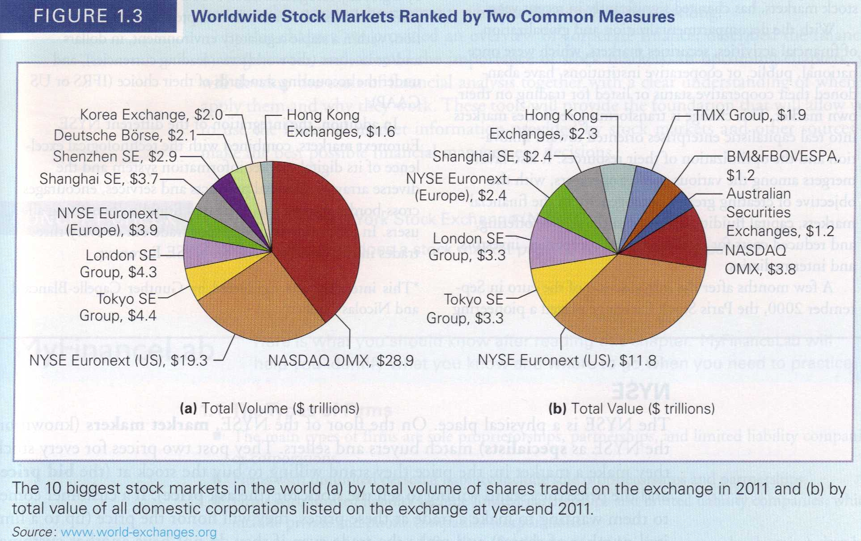
Worldwide Stock Markets
Source: Berk / DeMarzo (2014), p. 15

Slide 11
German Stock Market (DAX)
Status: Oct. 24, 2017

Slide 12
Austrian Stock Market (ATX)
Status: Oct. 24, 2017

Slide 13
Austrian Banking Sectors 2016
Source: OeNB (2017)

Slide 14
Some facts to compare …
Top 10 Austrian Banks – Total Assets 2016:
  ERSTE Bank: € 208,2 bn RLB OÖ: € 32,3 bn
  RZB/RBI: € 134,8 bn RLB NÖWien: € 25,4 bn
  Bank Austria: € 105,8 bn VB-Group: € 24,5 bn
  BAWAG/PSK: € 39,7 bn Oberbank: € 19,2 bn
  OeKB: € 32,8 bn Hypo Vbg.: € 13,3 bn
Selected International Banks – Total Assets 2016:
  BNP Paribas: € 2.077 bn Mitsubishi UFJ: ~ $ 2.740 bn
  Deutsche Bank: € 1.591 bn HSBC Holdings: $ 2.375 bn
  Santander: € 1.339 bn Bank of America: $ 2.188 bn
  UniCredit Grp: € 860 bn CitiGroup: $ 1.792 bn
  ING Group: € 845 bn Lloyd’s Bk. Grp.: £ 818 bn

Slide 15
Bank loans in Austria
Loans to Domestic Customers
(in EUR bn)
 | 2008 | 2009 | 2010 | 2011 | 2012 | 2013 | 2014 | 2015 | 2016 | 2017 Q2
Non-Financial Corporations | 133.6 | 130.2 | 133.3 | 136.9 | 138.1 | 137.4 | 132.6 | 132.7 | 134.6 | 136.7
Households | 121.5 | 121.3 | 128.4 | 131.7 | 132.7 | 132.9 | 135.7 | 141.6 | 146.0 | 146.9
Loans to Non-domestic Customers
 | 2008 | 2009 | 2010 | 2011 | 2012 | 2013 | 2014 | 2015 | 2016 | 2017 Q2
Non-Financial Corporations and Households | 116.6 | 111.4 | 110.7 | 117.0 | 112.3 | 110.0 | 102.8 | 102.1 | 95.1 | 95.2
Source: OeNB (2009 - 2017)

Slide 16
Agenda
Types of Financial Systems
Characteristics and Indicators
Functions and Impact on the Real Economy
Recent Developments and Incompatibilities
Outcome and Outlook

Slide 17
Prerequisites for Efficient Market
Homogeneous Products
Constant Liquidity
  Sufficiently large number of buyers and sellers constantly trading goods
Symmetric Information Distribution
  Market participants have access to the same information at the same time at no cost
Transaction Cost Free Environment
  No entry barriers, no exit barriers, no mobility barriers
  No charges/fees for trading, no taxes
Economically Rational Behaviour of Participants
  Concept of the “homo oeconomicus”
  Rational expectations and profit-seeking motive

Slide 18
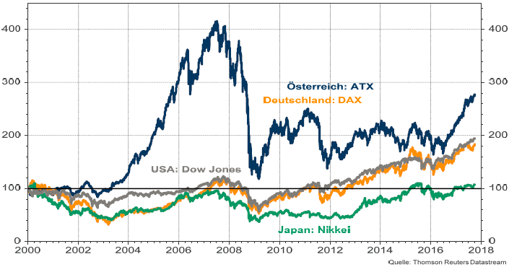
Development of Stock Markets 2000 – 2017
Source: RLB NÖ-Wien Treasury (Oct. 3, 2017)

Slide 19
Agenda
Types of Financial Systems
Characteristics and Indicators
Functions and Impact on the Real Economy
Recent Developments and Incompatibilities
Outcome and Outlook

Slide 20
The Banking Union to complete the European Economic and Currency Union
Banking Union
Single Supervisory Mechanism for banks (SSM)
Single Resolution Mechanism (SRM)
Harmonised Deposit Guarantee / Insurance System
Establishing a Single Supervisory Mechanism
Systemically Important Banks: direct supervision by ECB assisted by NCAs (since Nov. 4, 2014)
Less Important Banks: supervision by NCAs; crucial decisions have to be communicated to ECB
Comprehensive assessment of Systemically Important Banks in 2014: Supervisory Risk Assessment; Asset Quality Review (AQR); Stress Testing
Single Resolution Mecha-nism shall enable the struc-tured resolution of (espe-cially internationally active) banks
Financing the resolution by a common Resolution Fund sponsored by contributions of banks
In force: since 2015
Aim is to improve the protection of depositors (natural persons)
The „Single Rule Book“ has been mentioned frequently as another pillar of the Banking Union. It is considered to be „the sum of all rules composing the legal framework for the concession, supervision and resolution of banks in Europe.“ It comprises the CRR and the CRD IV (implementation in Austria by Banking Act and many other laws) as well as all Binding Regulatory and Implementation Standards published by the European Banking Authority (EBA) and the Bank Recovery and Resolution Directive (BRRD).
The aim of the Single Rule Book is to establish high common standards for the regulation and supervision of banks in all EU member states without favouring domestic market participants over international.“ (OeNB)
Source: EY (2014)

Slide 21
The Capital Markets Union to create a single European market for corporate funding
Initiative to create a genuine EU-wide domestic capital market
  i.e. to better integrate the individual capital markets of the EU-MS
Capital markets union action plan
  Financing for innovation, start-ups and non-listed companies
  Making it easier for companies to enter and raise capital on public markets
  Investing for long term, infrastructure and sustainable investment
  Fostering retail investment
  Strengthening banking capacity to support the wider economy
  Strengthening the capacity of EU capital markets
  Facilitating cross-border investment
Source: https://ec.europa.eu/info/business-economy-euro/growth-and-investment/capital-markets-union_en

Slide 22
Funding entrepreneurs: Markets or Banks ?
A successful entrepreneur searches for opportunities on the market and tries to make use of them!
A successful bank searches for risks and tries to manage them by avoiding, limiting, or transferring!
Investors provide equity to companies, banks provide debt!
Equity and debt have different return and risk profiles!

Slide 23
Equity vs. Debt – A Structured Comparison
Criterion | Equity | Debt
Liability for corporate debt | YES | NO
Maturity | NO | YES
Repayment agreement | NO | YES
Current / regular return | Dividend | Interest
Participation in substance / value gains | YES | NO
Governance / voting rights | YES | NO
Taxation of Cost of Capital | After-tax | Pre-tax

Slide 24
Investor’s Return Function
Investor’s
Return
ROI
Company’s
Success

Slide 25
Bank’s Return Function
Bank’s
Return
ROI
ROE
(Return on Equity)
Interest Payments
Company’s
Success
Collaterals

Slide 26
The situation in 2008 …
  The „fair and true“ balance sheet of US investment banks:
  There are two sides of the balance sheet: The left side and the right side.
On the left side,
there is
nothing right …
Balance Sheet
Fixed Assets
Financials
Intangibles
Current Assets
Cash / Liquidity
Equity
Long-Term Debt
Short-Term Debt
Provisions
… so on the right side,
there is nothing left.
1. Valuation
Problem !!!
2. Funding
Problem !!!

Slide 27
IFRS vs. EU-MS GAAP
Effects on the balance sheet
Balance Sheet
Fixed Assets
tangibles / property
intangibles
financials
Current Assets
inventories
accounts receivable
Cash / Liquidity
Equity
Long-Term liabilities
investment loan
issued securities
long-term provisions
Current Liabilities
accounts payable
overdrafts / bank loans
short-term provisions

Slide 28
Agenda
Types of Financial Systems
Characteristics and Indicators
Functions and Impact on the Real Economy
Recent Developments and Incompatibilities
Outcome and Outlook

Slide 29
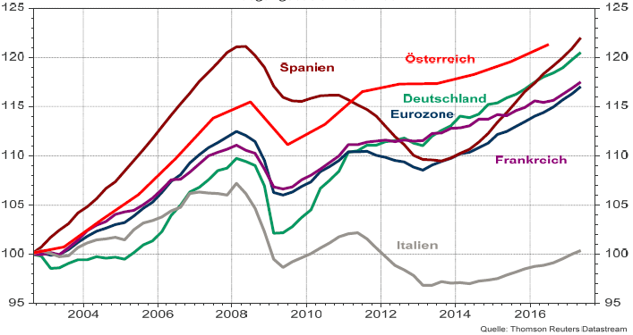
Real GDP: Eurozone + Selected Countries
Source: RLB NÖ-Wien Treasury (Oct. 3, 2017)

Slide 30
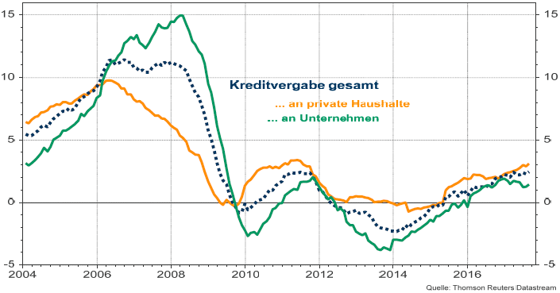
Bank lending to Non-Financial Sector (EU)
Source: RLB NÖ-Wien Treasury (Oct. 3, 2017)

Slide 31
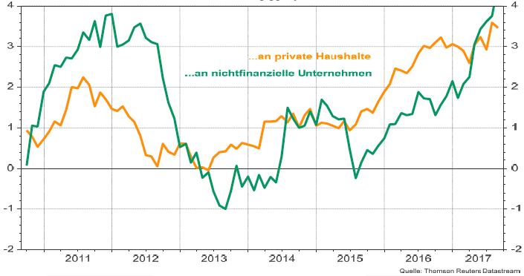
Bank lending to Non-Financial Sector (AT)
Source: RLB NÖ-Wien Treasury (Oct. 3, 2017)

Slide 32
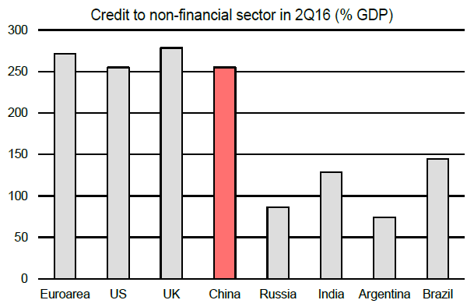
Global Risks still ahead!
Global Risk #1: China: The economy is highly leveraged!
Source: Erik Nielsen, UniCredit Research (Oct. 2, 2017)

Slide 33
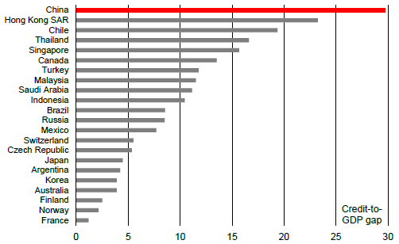
China’s Credit Bubble
All red warning lights are flashing!!!
Source: Erik Nielsen, UniCredit Research (Oct. 2, 2017)

Slide 34
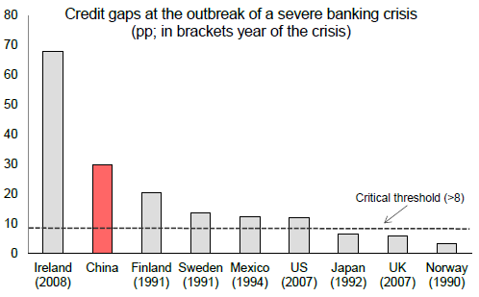
China’s Credit Bubble
If „credit gap“ exceeds 8, the burst of the bubble is near!
Source: Erik Nielsen, UniCredit Research (Oct. 2, 2017)

Slide 35
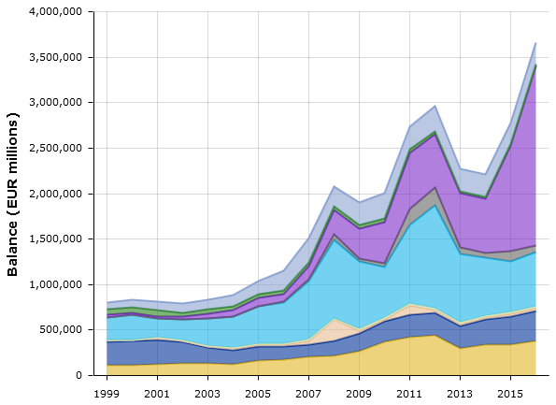
Central banks & real economies
Is „quantitative easing“ the right remedy?
Oct. 13, 2017:
€ 4.372 Mrd.
Source: ECB (Oct. 23, 2017)

Slide 36
Central banks & real economies
ECB Lending rate & Euribor (2008 - 2017)
Source: de.euribor-rates.eu

Slide 37
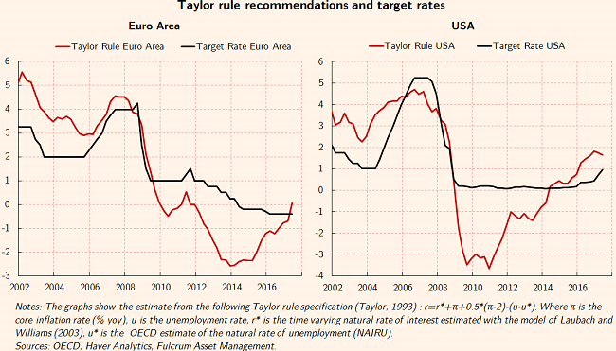
Central banks & real economies
Are zero-interest rates „real“ prices for money?
Source: Gavyn Davies, Financial Times (Sept. 10, 2017)

Slide 38
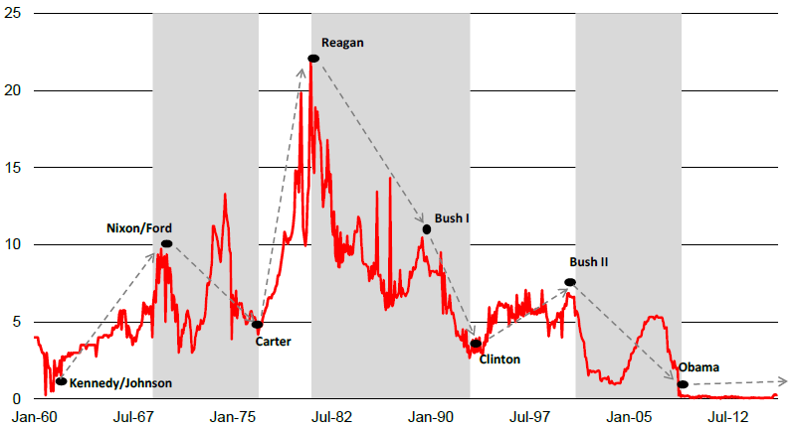
The „political cycle“ in US-interest rates
Federal Reserve Fund rates (in %)
(grey-shaded areas mark periods with Republican presidents!)
Source: Erik Nielsen, UniCredit Research (Oct. 2, 2017)

Slide 39
Resume & Outlook
Current changes in EU …
  … reduce the importance of financial institutions,
  … enhance the role of markets for more efficiency,
  … enable higher volatilities on markets,
  … increase the imbalances on markets by regulation that causes asymmetric information and outcome,
  … decrease the possibilities of moderate growth,
  … create stiffer competition among competitors that should not compete against each other,
  … increase complexity of financial systems and their participants,
  … lift the risks for real economies, the private and the public sector, and, in the long run …
  … prepare the ground for other crises to come!

Slide 40
Financial Systems and their Impact on Real Economy:
Prerequisites, Characteristics, Functions, and Incompatibilities
Finance and Social Justice Oct. 28, 2017
European Confederation of Jesuit Alumni/ae Vienna
Dr. Bernulf Bruckner

